Slide 1
Transformers
Plaban Kumar Bhowmick
Department of AI
plaban@ai.iitkgp.ac.in

Slide 2

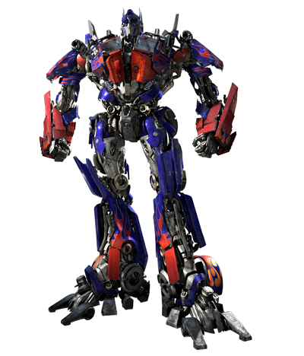
Transformer
Let us unfold the Beast

Slide 3
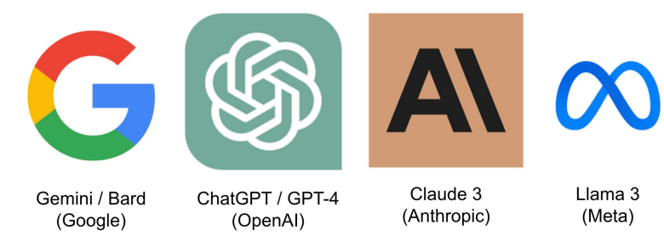

Transformer and NLP
Almost all the Large Language Models have Transformer as foundation
Sometimes near human performance

Slide 4

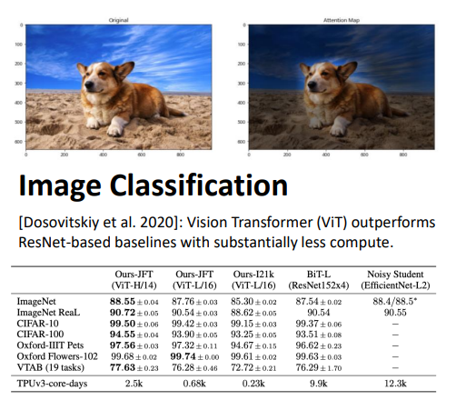
Transformers Outside of NLP

Slide 5
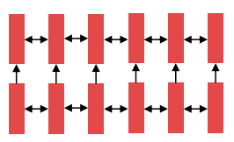
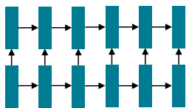
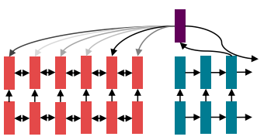
State of NLP Sometime Back
Encode sentences with a bidirectional LSTM
Define your output (parse, sentence, summary) as a sequence, and use an LSTM to generate it.
Use attention to allow flexible access to memory

Slide 6
Three Design Goals
Minimize (or at least not increase) computational complexity per layer.
Minimize path length between any pair of words to facilitate learning of long-range dependencies.
Maximize the amount of computation that can be parallelized.

Slide 7
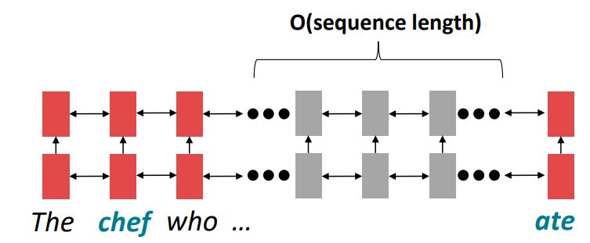
Minimize Linear Interaction Distance
RNNs are unrolled “left-to-right”
It encodes temporal (linear) locality: a useful heuristic!
Nearby words often affect each other’s meanings
Problem: RNNs take O(sequence length) steps for distant word pairs to interact.

Slide 8
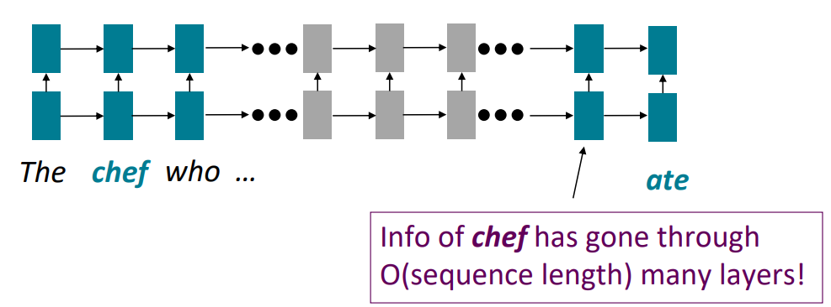
Minimize Linear Interaction Distance
Implication of O(sequence length) steps
Hard to learn long-distance dependencies (because vanishing gradient problems!)
Sequential structure doesn't tell the whole story

Slide 9
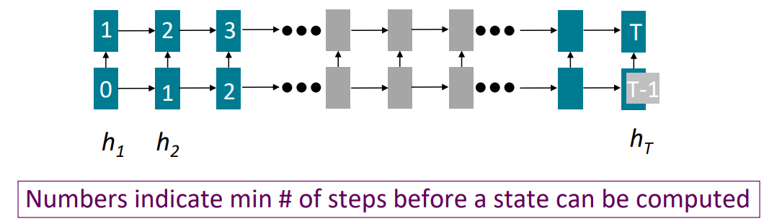
Maximize Parallelizability
Forward and backward passes have O(seq length) unparallelizable operations
Future RNN hidden states can’t be computed in full before past RNN hidden states have been computed
Inhibits training on very large datasets!

Slide 10
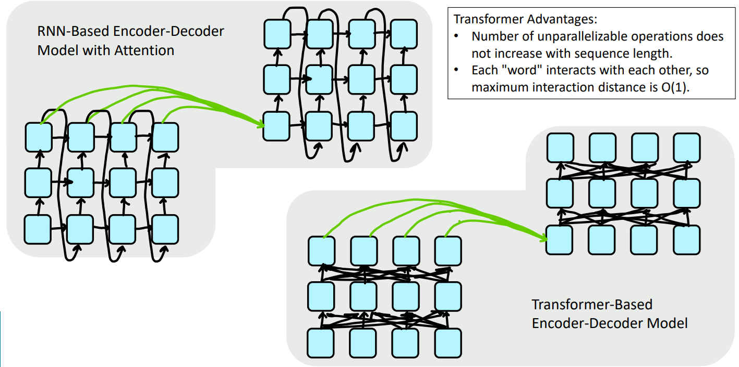
Self and Cross Attention at the Heart

Slide 11
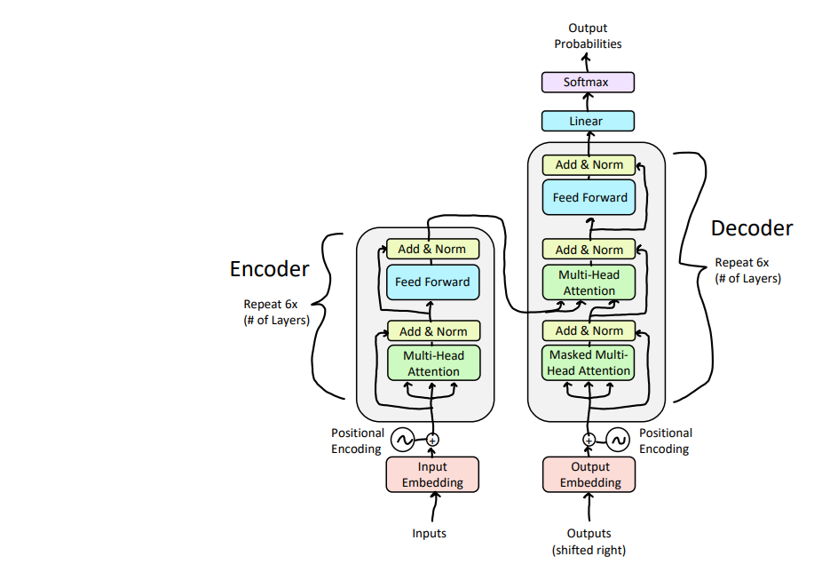
Encoder-Decoder Architecture

Slide 12
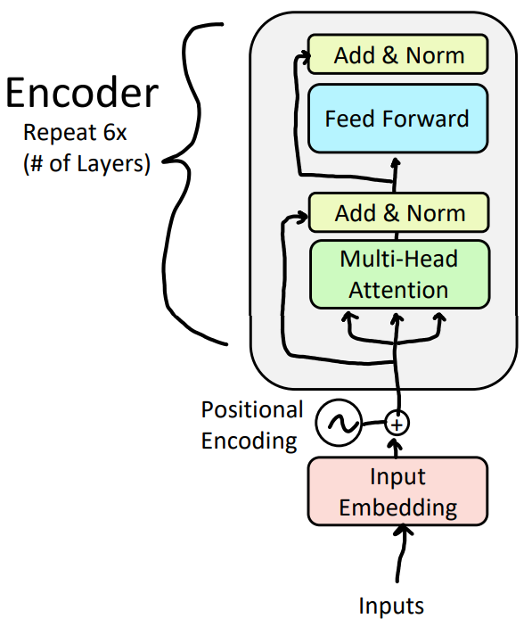

Slide 13
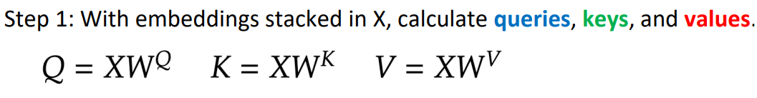
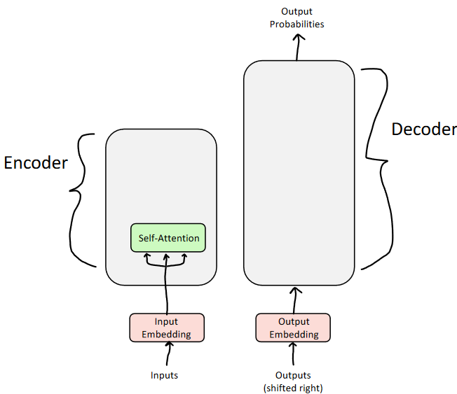
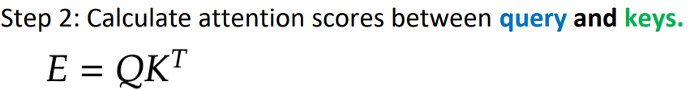
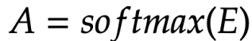
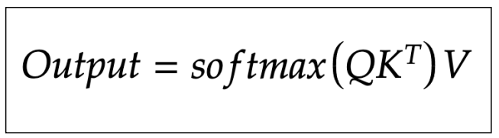

The (Self) Attention Mechanism

Slide 14
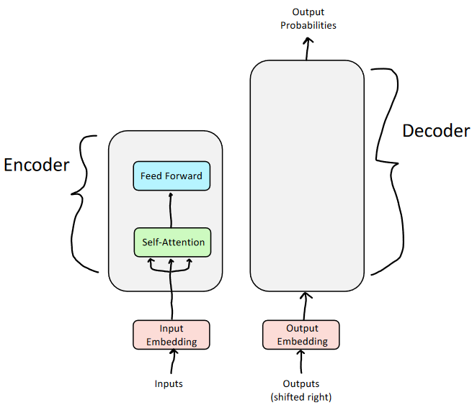
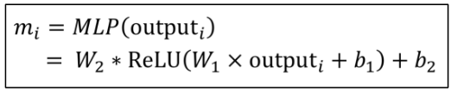
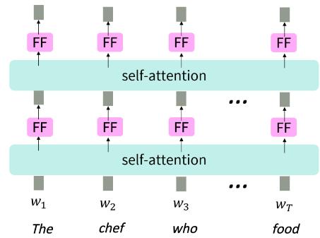
Adding Non-Linear Activation
Problem: Since there are no element-wise non-linearities, self-attention is simply performing a re-averaging of the value vectors.
Solution: Apply a feedforward layer to the output of attention, providing non-linear activation (and additional expressive power).

Slide 15
Making it Deep
Training Trick #1: Residual Connections
Training Trick #2: LayerNorm
Training Trick #3: Scaled Dot Product Attention

Slide 16
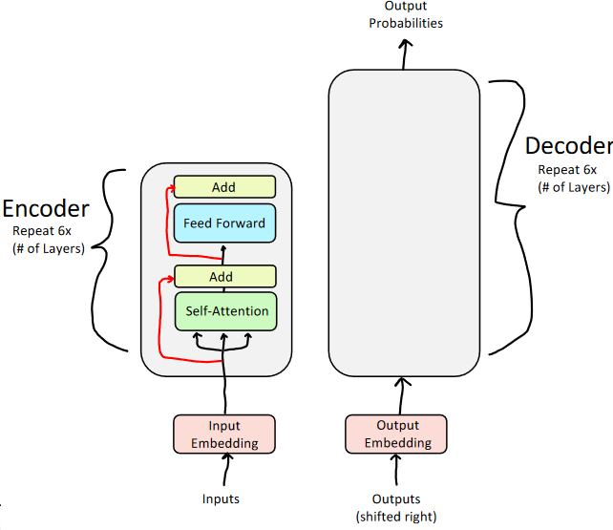
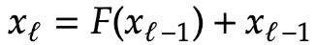
Residual Connection
Add Residual Connections
Directly passing "raw" embeddings to the next layer can actually be very helpful!
Prevents the network from "forgetting" or distorting important information

Slide 17
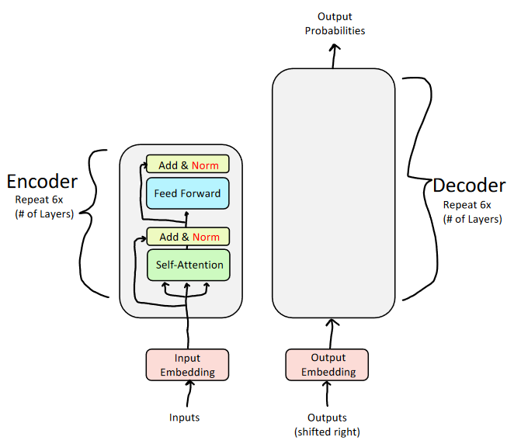
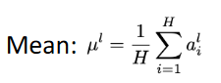
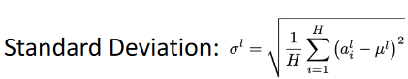
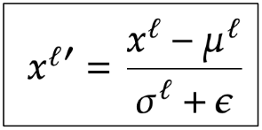
The Normalization Trick
Layer Normalization
Reduce variation by normalizing to zero mean and standard deviation of one within each layer

Slide 18
Normalization
Normalization in deep learning refers to the process of transforming input data or intermediate activations
To exhibit specific statistical properties, such as having a mean of zero and a standard deviation of one.
Normalization in DL benefits from:
Improved training stability
Faster convergence
Mitigating Internal covariate shift

Slide 19
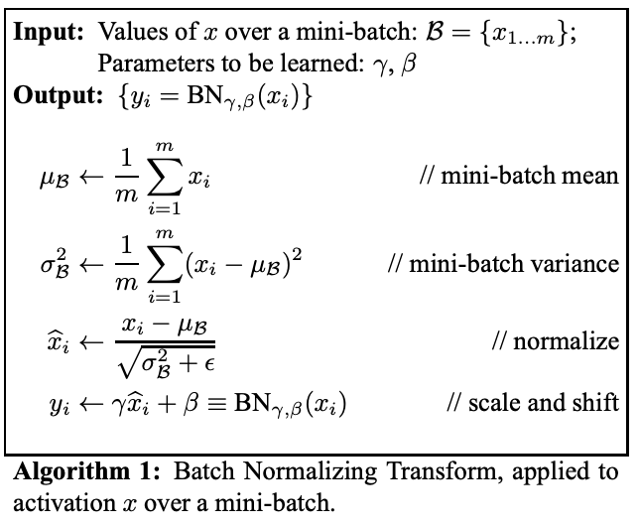
Recap on Batch Normalization
We normalize across the batches, i.e., we find mean and standard deviation across the entire batches.

Slide 20
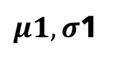
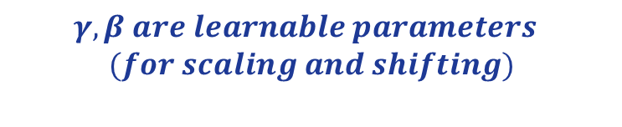
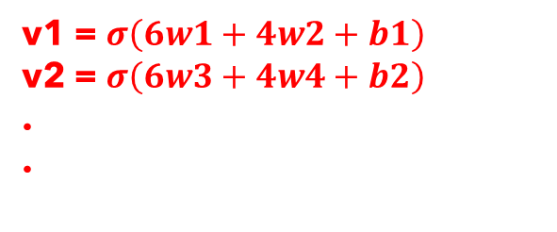
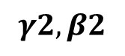
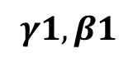
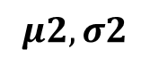
Batch Normalization: An Example
Let say we have a neural network that gives output z1 and z2 after the hidden layer.
Perform normalization across the batches (columnwise).
b1
$$γ1,β1$$
f1 | f2 | z1 | z2
6 | 4 | v1 | v2
5 | 3 | v3 | v4
1 | 3
2 | 8
5 | 2
w1
f1
w3
w2
y
f2
w4
b2
$$γ2,β2$$
$$μ2, σ2$$
$μ1, σ$1
v1 = $σ\left(6w1+4w2+b1\right)$
v2 = $σ\left(6w3+4w4+b2\right)$
.
.
$$γ,β are learnable parameters$$
$$(for scaling and shifting)$$

Slide 21
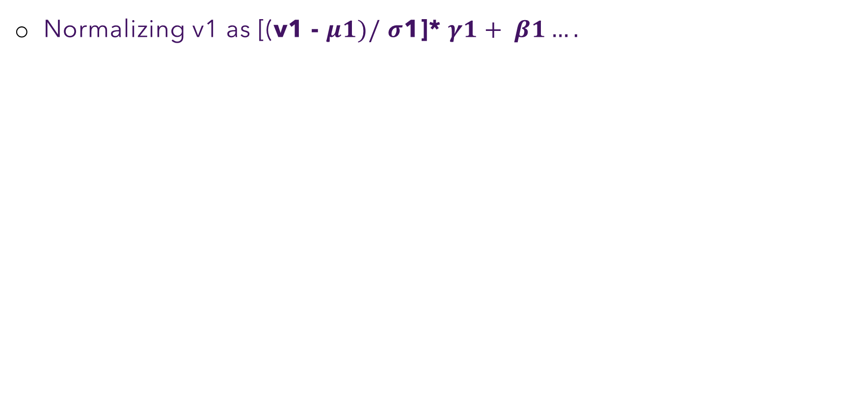
Batch Normalization: An Example
Normalizing v1 as [(v1 - $μ1)/$ $σ$1]* $γ1+ β1….$
b1
f1 | f2 | z1 | z2
6 | 4 | v1 | v2
5 | 3 | v3 | v4
1 | 3
2 | 8
5 | 2
w1
f1
w3
w2
y
f2
w4
b2
$μ1, σ$1
$$μ2, σ2$$
v1 = $σ\left(6w1+4w2+b1\right)$
v2 = $σ\left(6w3+4w4+b2\right)$
.
.

Slide 22
Why not use batch normalization in Transformers?
Batch normalization does not works well with sequential data!
Consider a sentence for sentiment analysis:-
We take embedding dimension=3 and batch size=2.
Review | Sentiment
Hi Groot | 1
How’s it going | 0
fine | 1
A lovely morning | 1

Slide 23
Why not use batch normalization in transformers?
Each word in these sentences is represented by an embedding vector:-
In self-attention, we need to ensure that the number of tokens in each sentence is equal.
0.2 | 0.4 | 0.3
0.4 | 0.2 | 0.3
0 | 0 | 0
Hi
Groot
<padding>
0.3 | 0.6 | 0.2
0.1 | 0.9 | 0.3
0.2 | 0.5 | 0.4
How’s
it
going

Slide 24
Why not use batch normalization in transformers?
We get contextual embeddings after passing through the self-attention block.
Hi
6.5 | 2.0 | 3.2
2.0 | 0.4 | 3.6
0 | 0 | 0
7.5 | 9.2 | 1.5
2.2 | 1.1 | 6.7
2.9 | 2.3 | 6
How’s
it
going
Groot
<padding>
Self Attention
Hi
0.2 | 0.4 | 0.3
0.4 | 0.2 | 0.3
0 | 0 | 0
0.3 | 0.2 | 0.6
0.1 | 0.9 | 0.3
0.2 | 0.5 | 0.4
How’s
it
going
Groot
<padding>

Slide 25
Why not use batch normalization in transformers?
Stacking both contextual embeddings we get:-
As batch normalization is performed columnwise. A problem arises!
Hi
6.5 | 2.0 | 3.2
2.0 | 0.4 | 3.6
0 | 0 | 0
Groot
<padding>
How’s
it
going
7.5 | 9.2 | 1.5
2.2 | 1.1 | 6.7
2.9 | 2.3 | 6

Slide 26
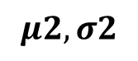
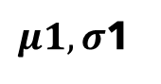
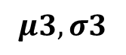
Why not use batch normalization in transformers?
Lets’s say our batch size is 32.
Longest sentence in these 32 sentences consists of 100 words and remaining sentences consists of 30-35 words.
Padding vectors increases drastically.
We cannot find true mean and standard deviation of such columns where most of it’s values are zero.
As batch normalization is performed columnwise. A problem arises!
Hi
6.5 | 2.0 | 3.2
2.0 | 0.4 | 3.6
0 | 0 | 0
Groot
<padding>
How’s
it
going
7.5 | 9.2 | 1.5
2.2 | 1.1 | 6.7
2.9 | 2.3 | 6
$μ1, σ$1
$$μ2, σ2$$
$$μ3, σ3$$

Slide 27
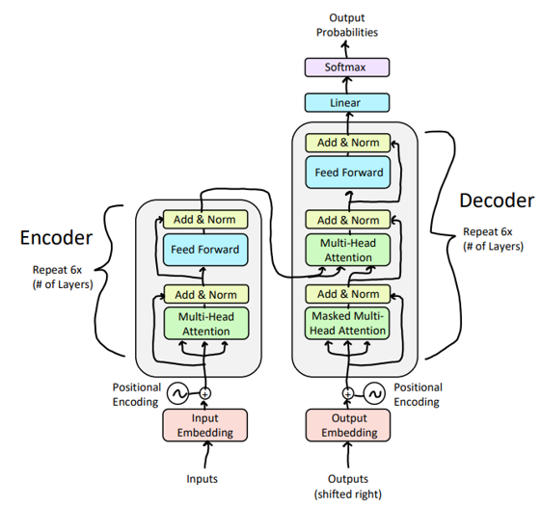
Solution: Layer Normalization
We normalize across the features, i.e., we find mean and standard deviation across the entire row.

Slide 28
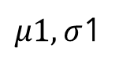
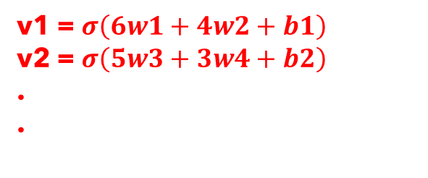
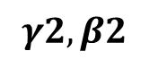
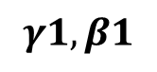
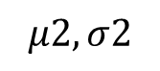
Layer Normalization: An Example
Let say we have a neural network that gives output z1 and z2 after the hidden layer.
Perform normalization across the features (rowwise).
b1
$$γ1,β1$$
f1 | f2 | z1 | z2
6 | 4 | v1 | v2
5 | 3 | v3 | v4
1 | 3
2 | 8
5 | 2
w1
$μ1, σ$1
f1
w3
w2
y
$$μ2, σ2$$
f2
w4
b2
$$γ2,β2$$
v1 = $σ\left(6w1+4w2+b1\right)$
v2 = $σ\left(5w3+3w4+b2\right)$
.
.

Slide 29
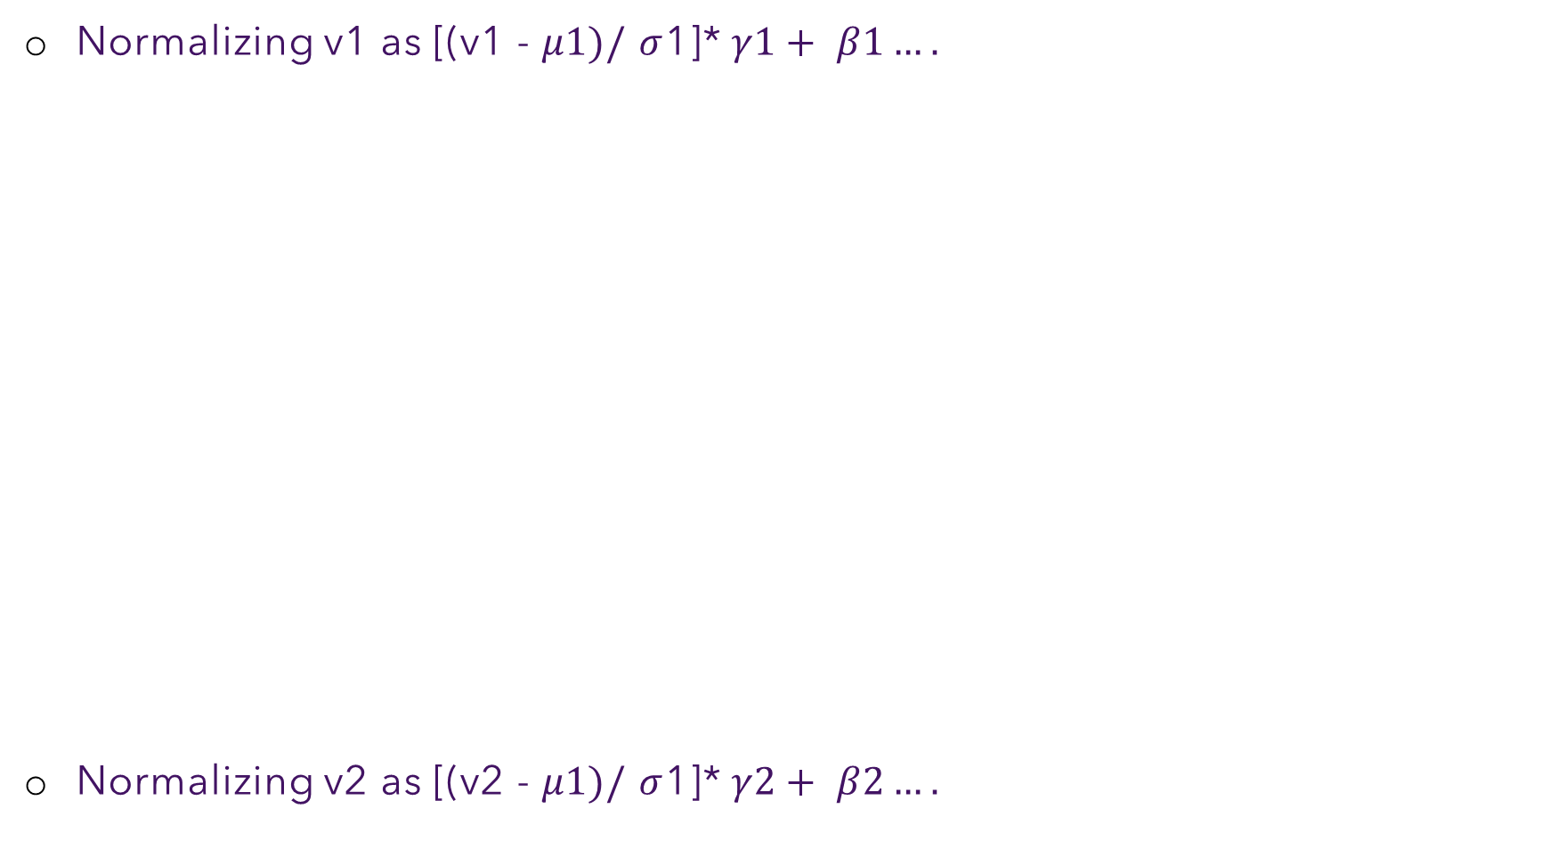
Layer Normalization: An Example
Normalizing v1 as [(v1 - $μ1)/$ $σ$1]* $γ1+ β1….$
Normalizing v2 as [(v2 - $μ1)/$ $σ$1]* $γ2+ β2….$
b1
f1 | f2 | z1 | z2
6 | 4 | v1 | v2
5 | 3 | v3 | v4
1 | 3
2 | 8
5 | 2
w1
$μ1, σ$1
f1
w3
w2
y
$$μ2, σ2$$
f2
w4
b2
v1 = $σ\left(6w1+4w2+b1\right)$
v2 = $σ\left(6w3+4w4+b2\right)$
.
.

Slide 30
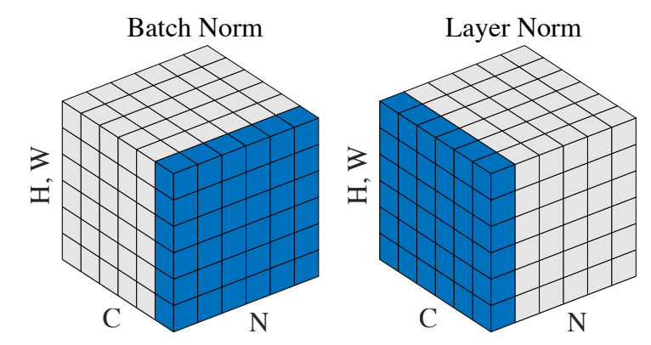
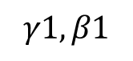
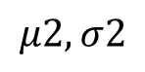
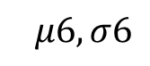
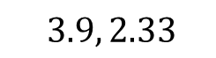
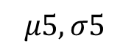





Layer Normalization
Eg:- [(6.5 - $3.9$)/ $2.33$] * $γ1$ + $β1$
[(2.0 - $3.9$)/ $2.33$] * $γ2$ + $β2$
[(3.2 - $3.9$)/ $2.33$] * $γ3$ + $β3$
Lets’s say our batch size is 32.
Longest sentence in these 32 sentences consists of 100 words and remaining sentences consists of 30-35 words.
Even if padding vectors increases drastically, normalizing across the rows still maintains the true mean and standard deviation.
As batch normalization is performed columnwise. A problem arises!
Hi
6.5 | 2.0 | 3.2
2.0 | 0.4 | 3.6
0 | 0 | 0
$$3.9, 2.33$$
Groot
<padding>
$$μ2, σ2$$
$$μ3, σ3$$
How’s
it
going
7.5 | 9.2 | 1.5
2.2 | 1.1 | 6.7
2.9 | 2.3 | 6
$$μ4, σ4$$
$$μ5, σ5$$
$$μ6, σ6$$
$$γ1,β1$$
$$γ2,β2$$
$$γ3,β3$$

Slide 31

Scaled Dot Product Attention
** For details, please refer to the note

Slide 32



Positional Encoding
Sense of position is lost
Sinusoidal position representations
Relative Position Encodings

Slide 33


Multi-Head Attention

Slide 34


Slide 35




Masked Multi-Head Self Attention
मैं आपको देख सकता हूं
<EOS>
MASK future tokens
Decoder should not see; otherwise it’s cheating

Slide 36

Decoder: Masked Multi-Headed Self-Attention

Slide 37







Encoder-Decoder Cross Attention
Let $h_{1}, …, h_{T}$ be output vectors from the Transformer encoder
$$V, K$$
Let $z_{1}, …, z_{T^{′}}$ be input vectors from the Transformer decoder
$$Q$$
Then keys and values are drawn from the encoder (like a memory):
$$k_{i}=Kh_{i}, v_{i}={Vh}_{i}$$
The queries are drawn from the decoder
$$q_{i}=Qz_{i}$$

Slide 38

A Bit More
Add a feed forward layer (with residual connections and layer norm)

Slide 39

A Bit More
Add a feed forward layer (with residual connections and layer norm)
Add a final linear layer to project the embeddings into a much longer vector of length vocab size (logits)
Add a final softmax to generate a probability distribution of possible next words!

Slide 40
Executing a Transformer

Slide 41



A High Level Look

Slide 42

Self Attention and Feedforward

Slide 43

Self Attention Visualization

Slide 44

Self Attention

Slide 45

Self Attention

Slide 46

Multi-Head Attention

Slide 47

Multi-Head Attention

Slide 48

Multi-Head Attention

Slide 49

Multi-Head Attention

Slide 50

Multi-Head Attention
HEAD #1
HEAD #5

Slide 51

Positional Encoding

Slide 52

Positional Encoding

Slide 53


Positional Encoding

Slide 54

Residual and Normalization

Slide 55

Encoder-Decoder Connection

Slide 56

Decoder Side

Slide 57

Decoder Side

Slide 58

The Final Linear and Softmax Layer

Slide 59

A Note on Training
** In real scenario, the output vocab is large (unique words in training corpora)

Slide 60

A Note on Training
Cross Entropy Loss

Slide 61


A Note on Training

Slide 62
Transformer #Parameter Calculation
Embedding layer
Parameters associated with the input and output embeddings for tokens, which encode their semantic meanings
Positional Encodings
Parameters used to encode positional information in the input sequences
Encoder Layers
Parameters within each encoder layer, including those associated with self-attention mechanisms, position-wise feedforward networks, and layer normalization
Decoder Layers
Parameters within each decoder layer, including self-attention mechanisms, cross-attention mechanisms, position-wise feedforward networks, and layer normalization.

Slide 63

Embedding Layer
Let $M$ be the maximum sequence length and $V$ the size of the vocabulary
$M×d_{m}$ positional embedding parameters, which are fixed and not learned
$V×d_{m}$ token embeddings parameters, which are trainable
No of trainable parameters
$N_{emb}=V×d_{m}=37000×512=18,944,000$

Slide 64

Other Blocks
Encoder
Multi-Head Attention
2x Layernorm
Feed Forward Network
Decoder
2x Multi-Head Attention
3x Layernorm
Feed Forward Network

Slide 65



Encoder Block: MHA
The input token embeddings have shape $d_{m}$ (embedding dimension)
Project input embeddings into Query, Keys and Values with matrices $W_{Q}$, $W_{K}$ , $W_{V}$ for each head
We have $n_{h}$ no of each Matrix
Project concatenated output of the Scaled Dot-Product Attention back to $d_{m}$ with $W_{O}$
$$n_{h}$$

Slide 66

Encoder Block: MHA
Project Input Sequence into Query, Key and Value:
Input shape: ${seq_len×d}_{m}$($seq_len$ is the number of tokens, where each has the embedding dimension of $d_{m}$)
For MHA we project $d_{m}$ to $d_{qkv}$ , with $d_{qkv}={d_{m}}/{n_{h}}$
We split up $d_{m}$ into $n_{h}$ heads and need $W_{Q}$, $W_{K}$ , $W_{V}$ for each head
Each Matrix has shape $d_{m}×d_{qkv}$
$$n_{h}$$

Slide 67


Encoder Block: MHA
$W_{O}$
Project concatenated output to the MHA output:
We concatenate the $n_{h}$outputs, where each has shape $d_{qkv}$ and end up with a shape of $d_{m}$ again
We then project $d_{m}$to $d_{m}$ with $W_{O}$
$W_{O}$ thus has a shape of $d_{m}×d_{m}$
$$n_{h}$$

Slide 68






Encoder Block: MHA
$$N_{MHA}=\left(d_{m}×d_{m}+d_{m}\right)$$
$W_{O}, b_{O}$
$$W_{O}, b_{O}$$
$$+ \left(d_{m}×d_{qkv}+d_{qkv}\right)× n_{h}×3$$
$$n_{h}$$
$$W_{QKV}, b_{QKV}$$
$$= \left(d_{m}×d_{m}+d_{m}\right)+\left(d_{m}×d_{m}+d_{m}\right)×3$$
$$= \left(d_{m}^{2}+d_{m}\right)×4$$
$$≈ 4×d_{m}^{2}$$

Slide 69







Feed Forward Network
The FFN of the Transformer uses two fully connected layers
Input and output size is both $d_{m}$
The hidden layer size is $4×d_{m}$
Weight matrices $W_{1}$ and $W_{2}$ therefore have shape $d_{m}×4.d_{m}$ and $4.d_{m}×d_{m}$ respectively
$$d_{m}$$
$$d_{m}$$
$${4d}_{m}$$
$$N_{FFN}=\left(d_{m}×{4.d}_{m}+{4.d}_{m}\right)+\left({4.d}_{m}×d_{m}+d_{m}\right)$$
$$=8.d_{m}^{2}+5.d_{m}$$
$$≈8.d_{m}^{2}$$

Slide 70





Layer Norm
We estimate $μ$ and $σ$ for each layer ($H$ denotes the number of hidden neurons in a layer ):
For rescaling the normalizations we need a $β$ and $γ$ parameter for each neuron in the layer
Since our layer has $d_{m}$ neurons we need ${2.d}_{m}$ ($d_{m}$pairs of $β,γ$) parameters for the Layer Norm operations
$$N_{LN}=2.d_{m}$$

Slide 71




Final Parameter Count
$$N_{enc}=1.N_{MHA}+1.N_{FFN}+2.N_{LN}$$
$$=4×\left(d_{m}^{2}+d_{m}\right)+8.d_{m}^{2}+5.d_{m}+2.(2.d_{m})$$
$$=12.d_{m}^{2}+13.d_{m}$$
$$N_{dec}=2.N_{MHA}+1.N_{FFN}+3.N_{LN}$$
$$=2.4.\left(d_{m}^{2}+d_{m}\right)+8.d_{m}^{2}+5.d_{m}+3.(2.d_{m})$$
$$=16.d_{m}^{2}+19.d_{m}$$
$$N_{enc_dec}=12.d_{m}^{2}+13.d_{m}+16.d_{m}^{2}+19.d_{m}$$
$$=28.d_{m}^{2}+32.d_{m}$$
$$≈28.d_{m}^{2}$$

Slide 72




Final Parameter Count
Number of encoder and decoder layers = 6
Embedding size: $d_{m}=512$
Vocab size: $V=37000$
Total number of parameters:
$$N_{total}=N_{emb}+{6.N}_{enc_dec}$$
$$N_{total}=V×d_{m}+6.28.d_{m}^{2}$$
$$=18, 944, 000 + 44, 040, 192 = 62, 984, 192$$
$≈63$ milion

Slide 73
Summary
Transformer is an encoder-decoder architecture
Architecture tuned to capture long range dependency
Architecture aims to maximize parallelizability
Transformer uses
Self attention (encoder or decoder)
Cross attention (encoder-decoder)
Masked attention (ignoring certain part of input)
Multi-head attention (stack of attention layers)
Foundation of all the LLMs

Slide 74



Transformer as Foundation of LLMs
Encoder Only
Decoder Only
BERT
T5
Decoder Only
GPT

Slide 75
Resources
Attention is All You Need
Vaswani et al.
https://arxiv.org/abs/1706.03762
Lecture 8: Transformers
CS224N: Natural Language Processing with Deep Learning
https://web.stanford.edu/class/archive/cs/cs224n/cs224n.1246/slides/cs224n-spr2024-lecture08-transformers.pdf
Transformer Implementation
https://nlp.seas.harvard.edu/2018/04/03/attention.html
The Illustrated Transformer
Blog by Jay Alammar
http://jalammar.github.io/illustrated-transformer/
Transformer Visualization
https://bbycroft.net/llm

